Slide 1
Gymnasium im Kannenbäckerland Höhr-Grenzhausen Germany

Slide 2
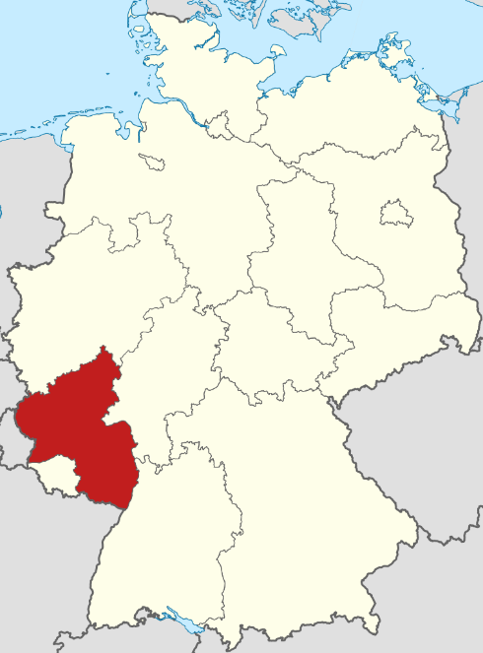
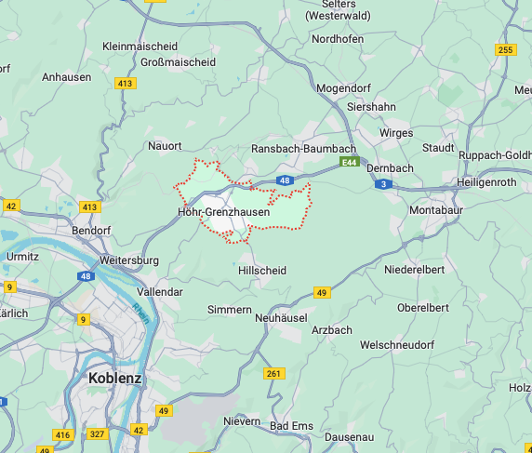
Höhr-Grenzhausen
town in the Westerwaldkreis in Rhineland-Palatinate
~ 9.500 inhabitants
three districts: Höhr, Grenzhausen, Kammerforst and Grenzau
geographical location: ~ 10 km west of Montabaur and 10 km northeast of Koblenz

Slide 3
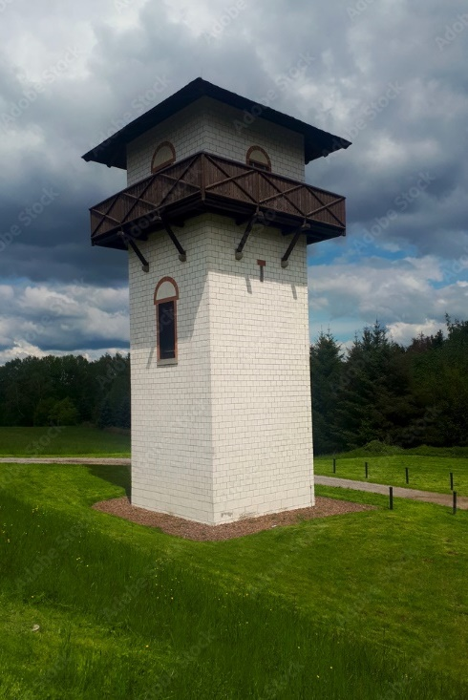
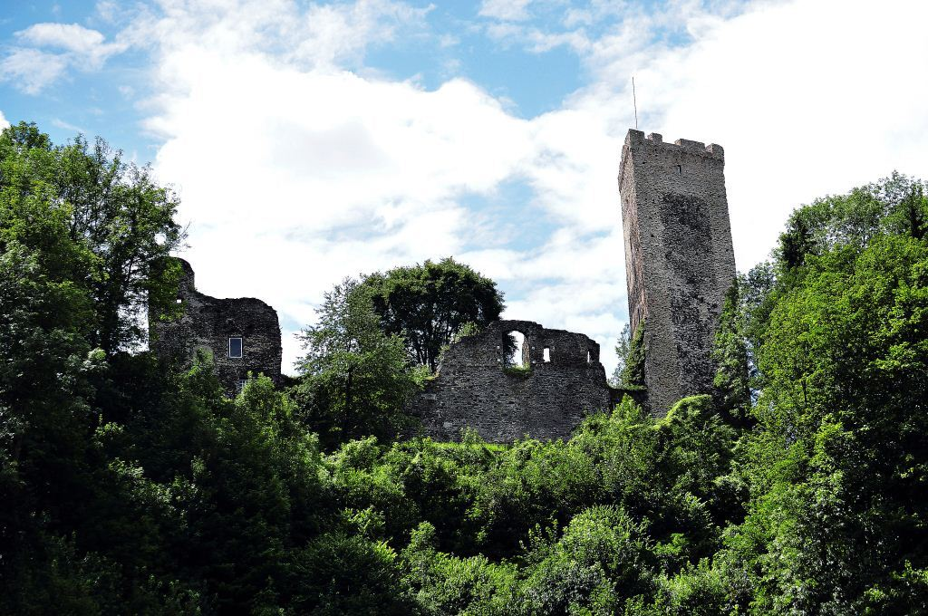
Höhr-Grenzhausen Culture and sightseeing
Sport: table tennis
Westerwald Ceramics Museum
Grenzau castle
the Limes Germanicus
the Westerwald: perfect for hiking

Slide 4
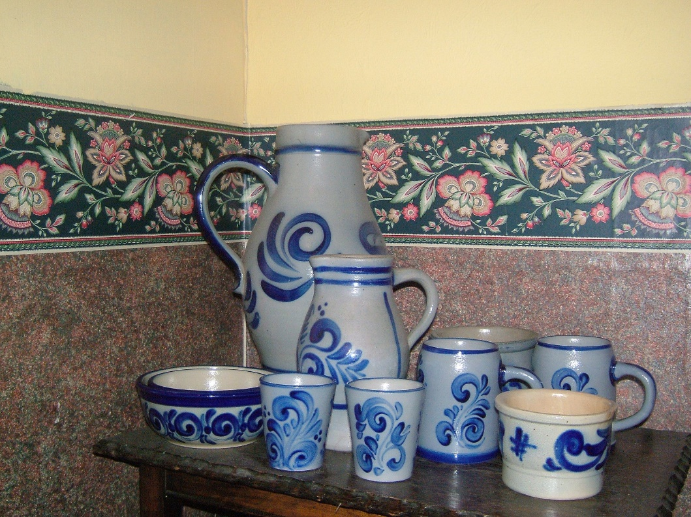
What‘s Kannenbäckerland?
literally: “jug bakers’ country”
centre for the ceramic industry
professional college for ceramics (next to our school)
Typical saltglazed stoneware in grey and blue

Slide 5
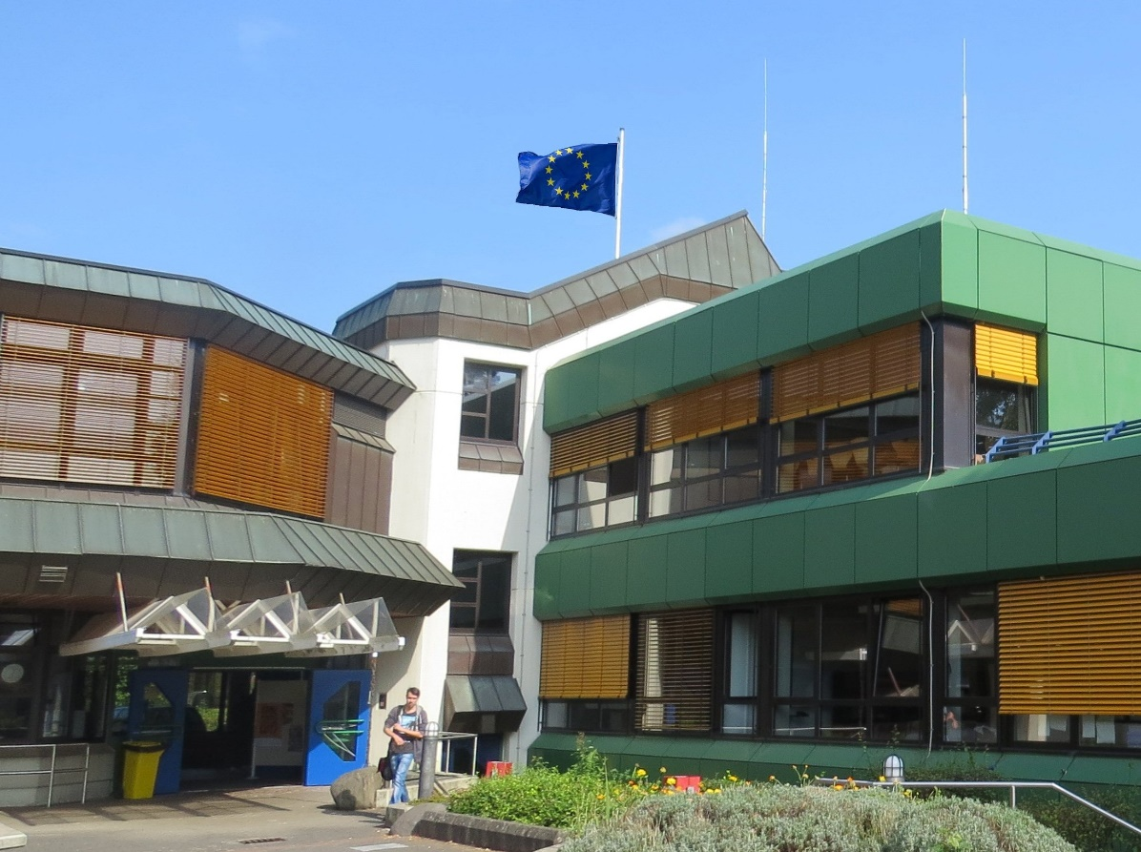
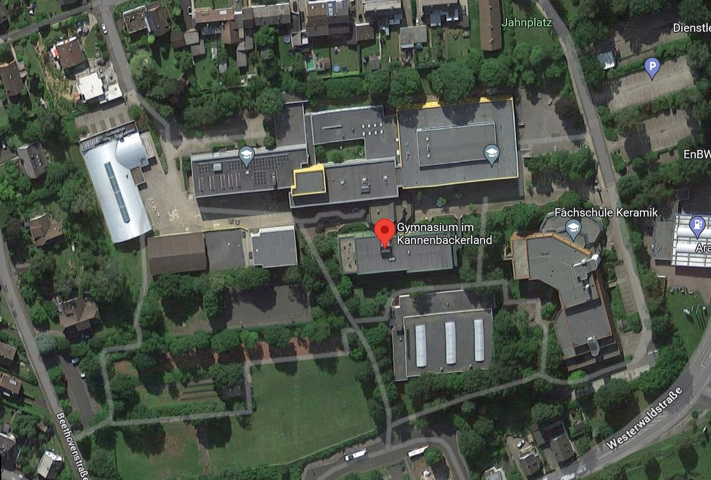
Our school
Teachers: 57
Students: 465
Year 5-12: 11-18 years old
G8GTS school (G8 = A levels after 12 years; GTS = all day school)

Slide 6
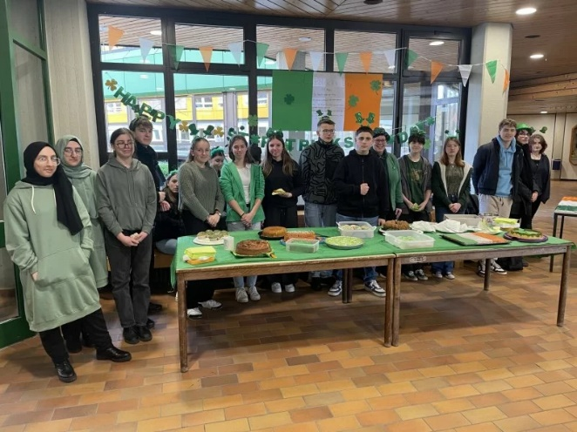
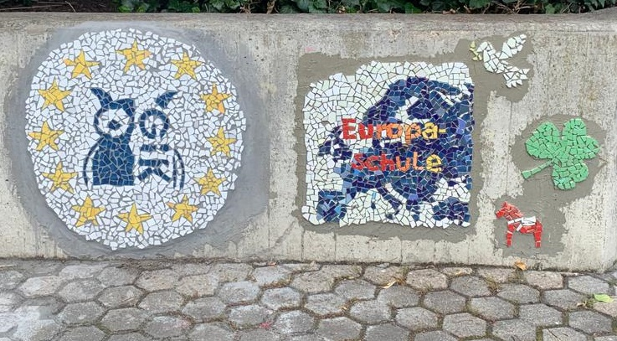
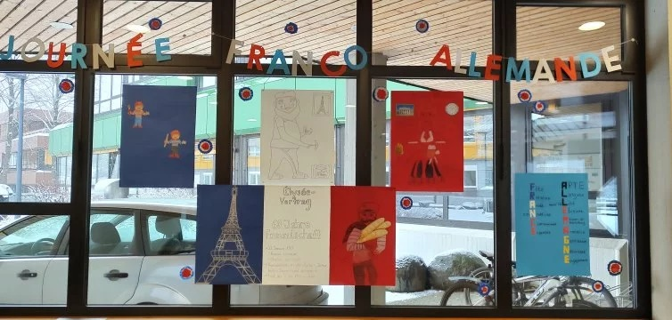
European school since 2017
“European classes” in Year 5
Different European-themed projects e.g. mosaic
Excursions to Brussels, Strasburg
Celebration of the European week and other European holidays
Success at European Art Competition
E-twinning project with Turkey, Poland and Azerbaijan -> awarded with 600 € prize money

Slide 7
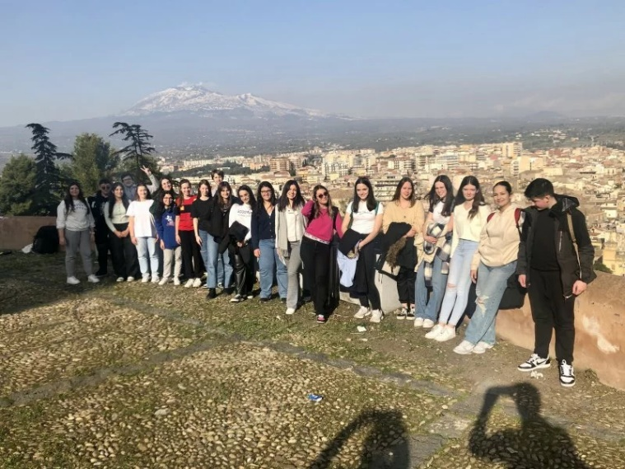
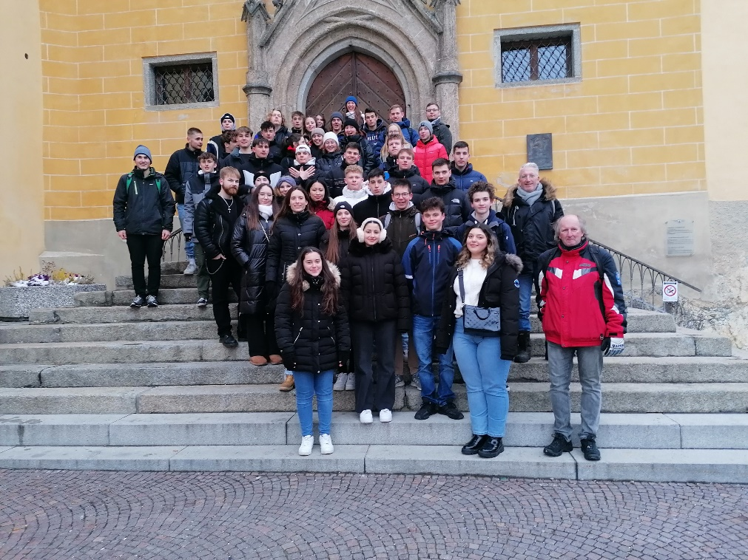
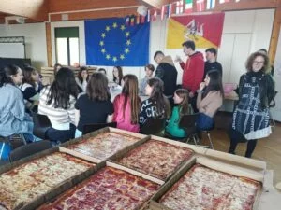
Erasmus+ since 2022
Exchange with Catania/ Italy – Project on Romans in Sicily and Westerwald
Intercultural meeting in Bruneck/ Italy -> various projects on sustainability, environmental protection
Multilingual exchange with Milan/ Italy (planned)

Slide 8
Languages at GiK
English from Year 5
French or Latin from Year 6
Italian from Year 8 (optional)
Russian and Turkish for native speakers (optional)
German as a second language (remedial teaching)

Slide 9
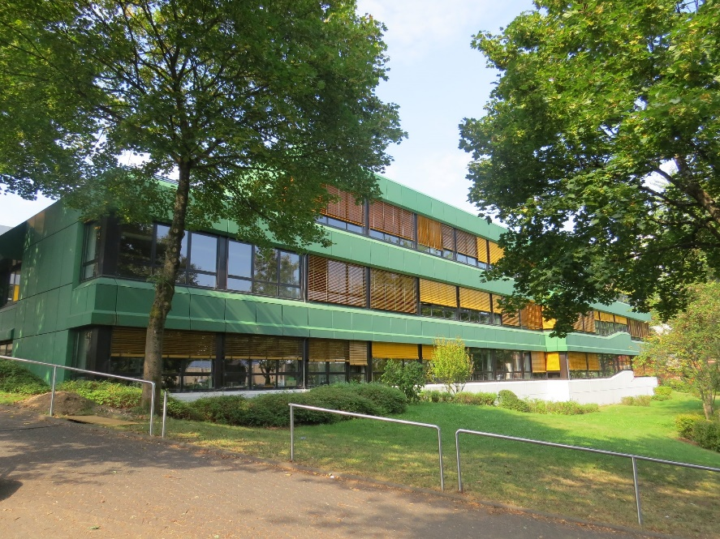
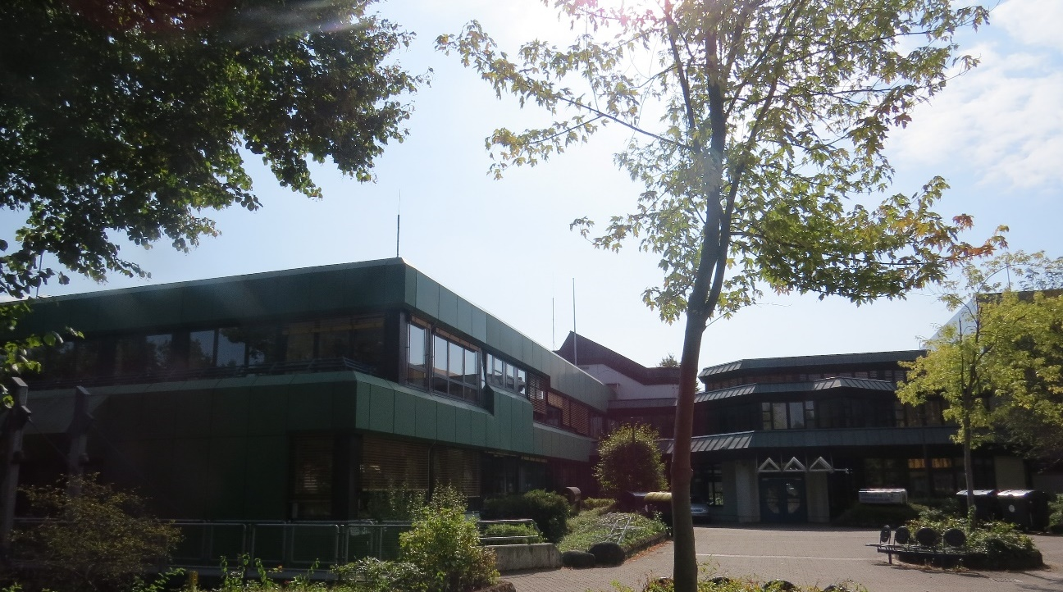
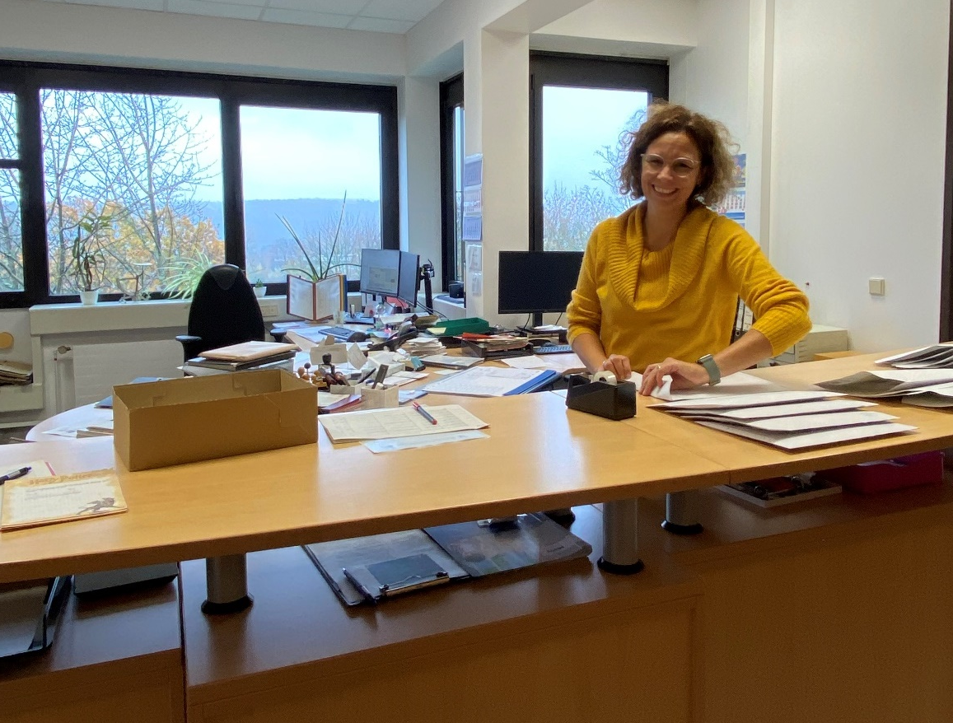
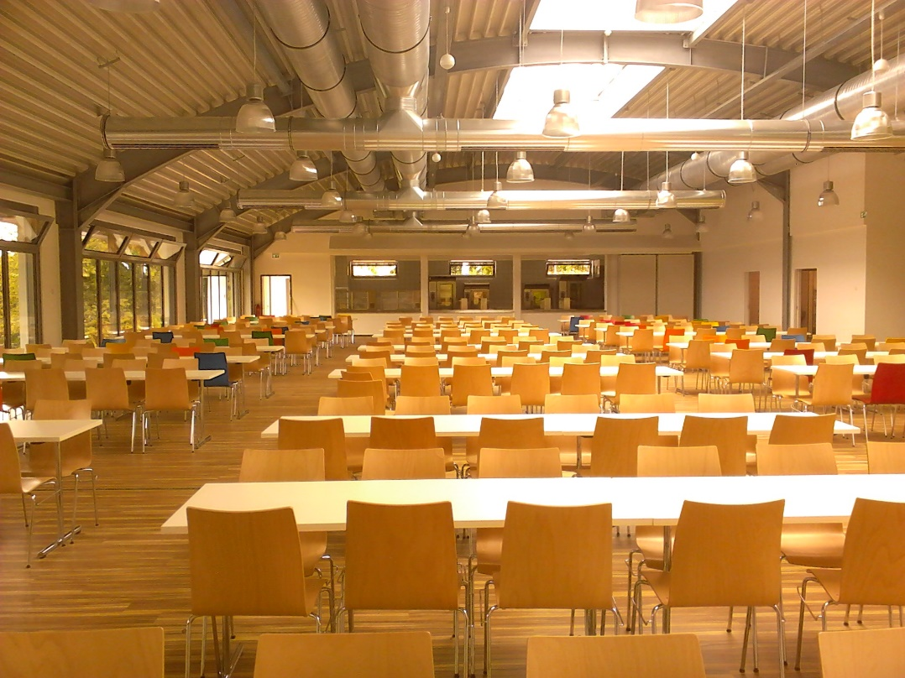
Facilities

Slide 10
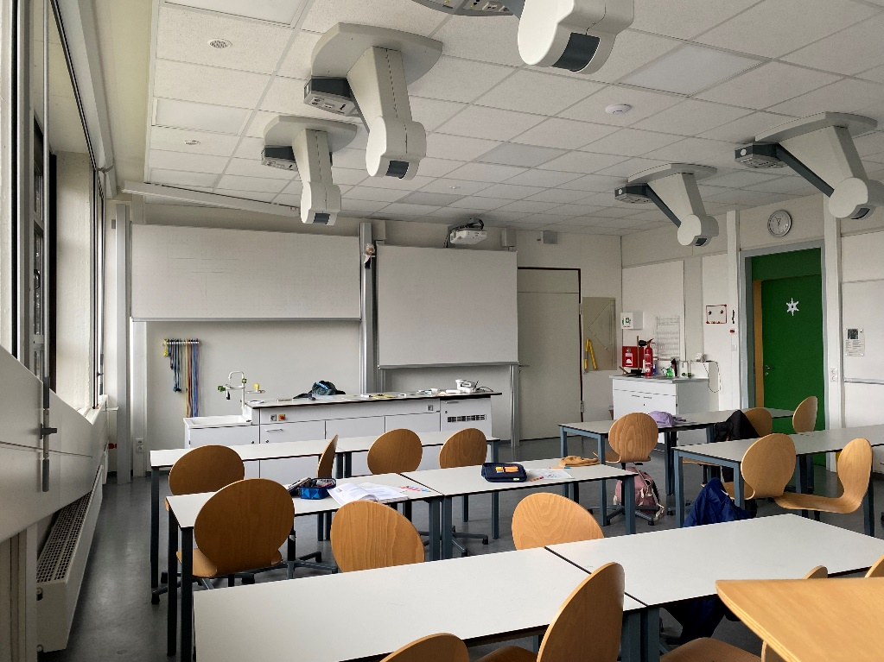
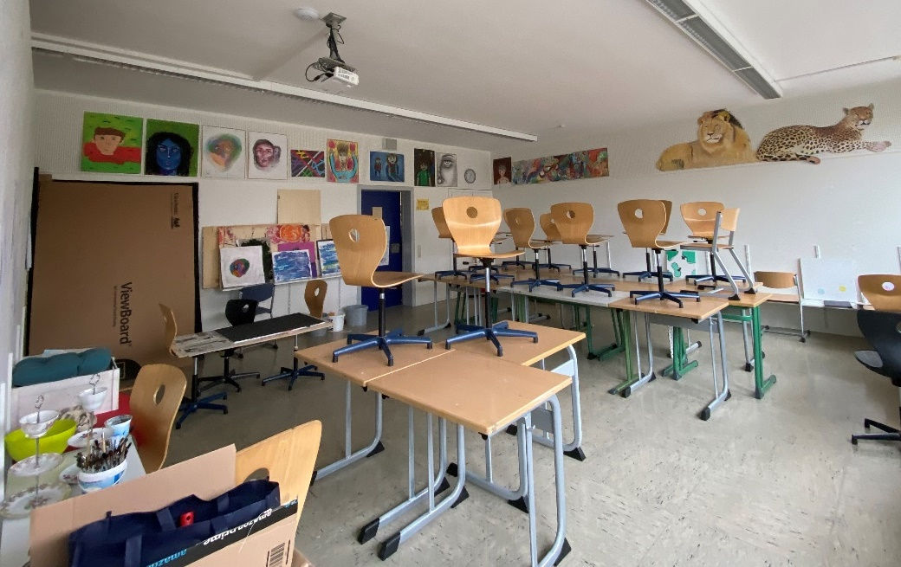
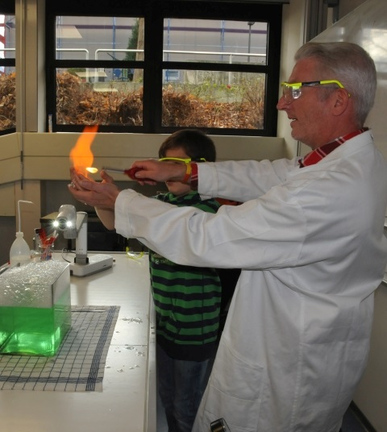
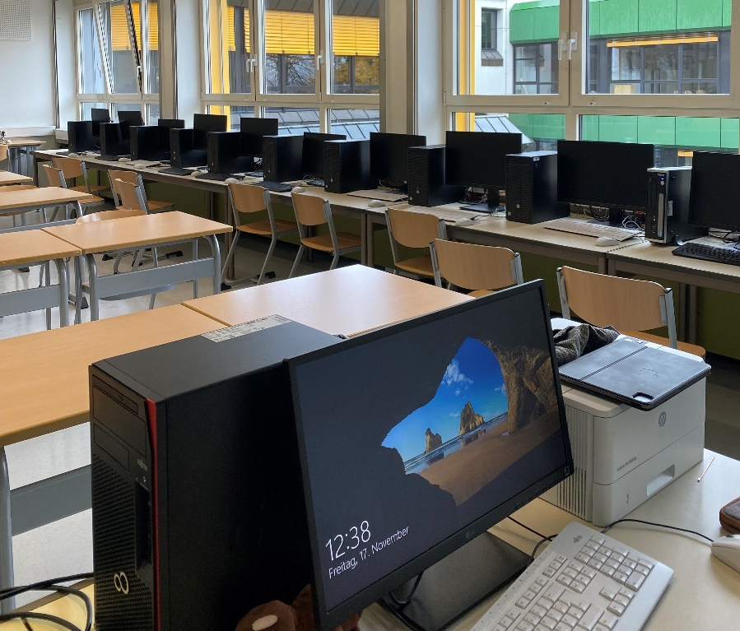
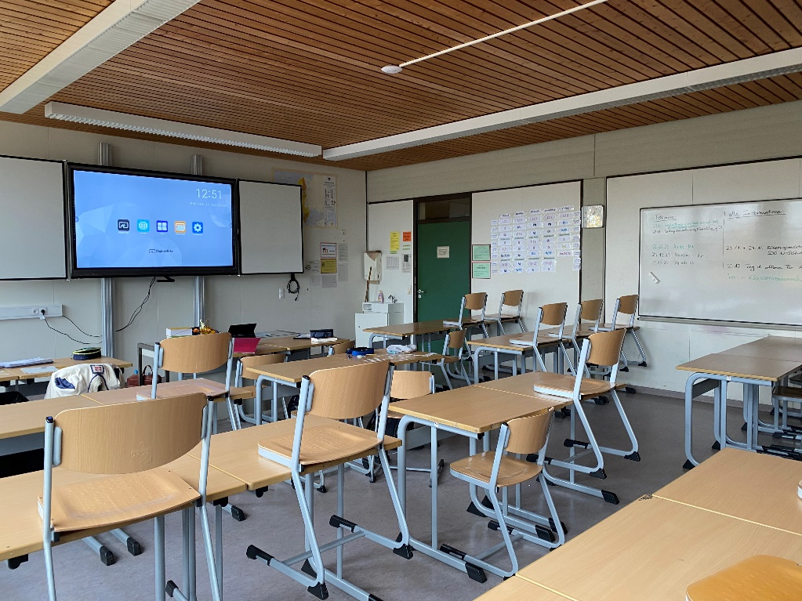
Facilities

Slide 11
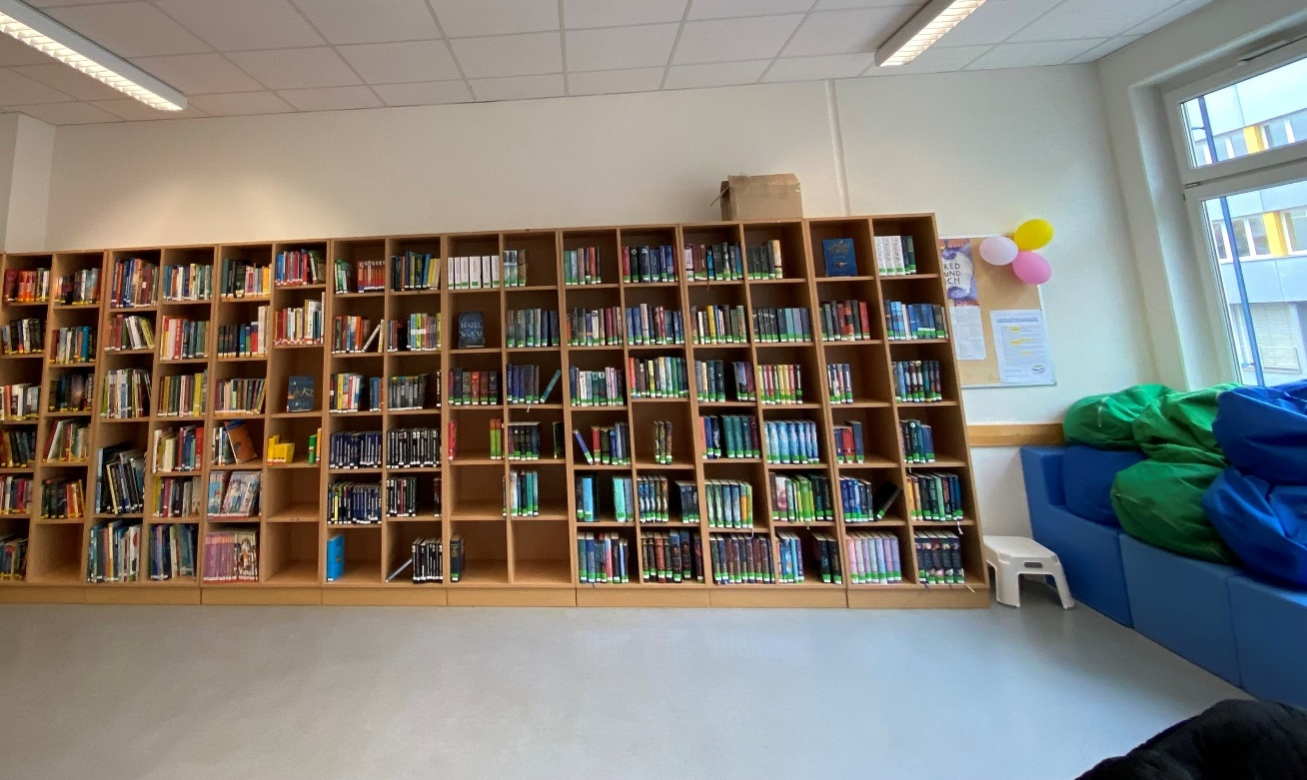
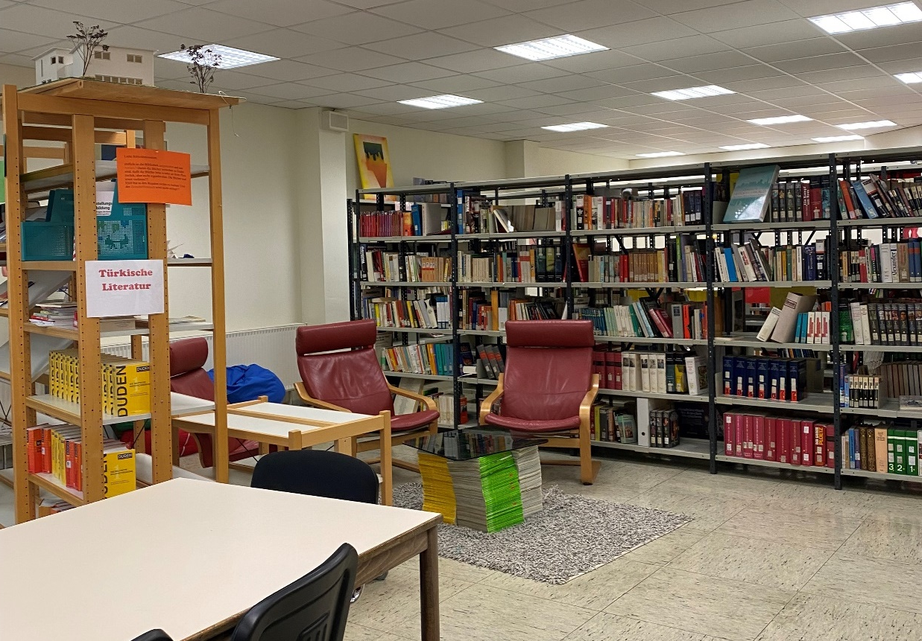
Facilities

Slide 12
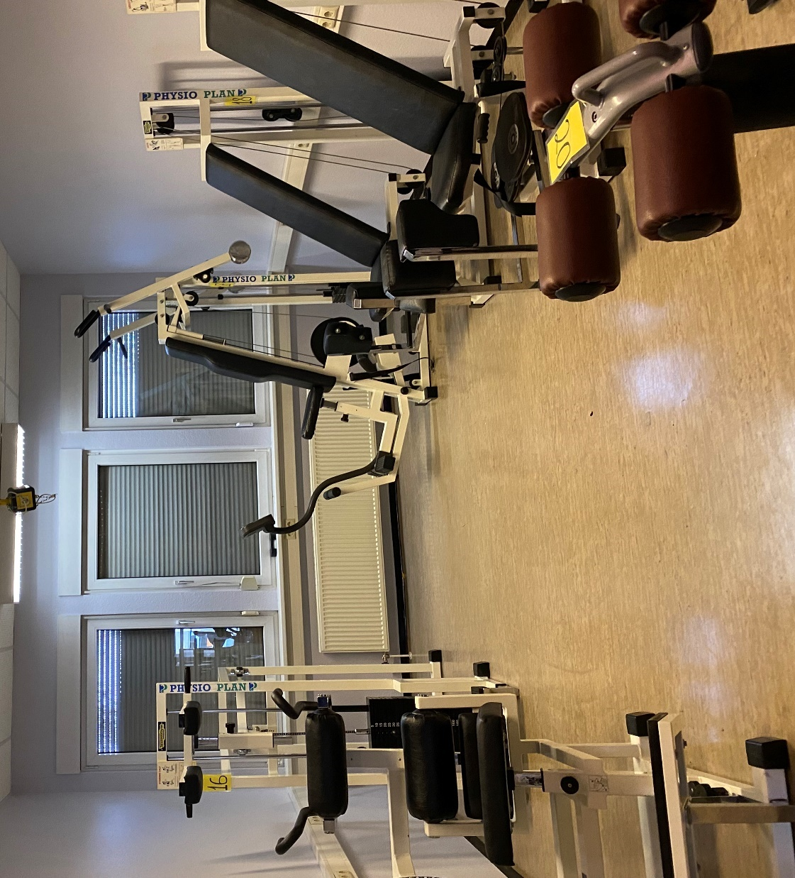
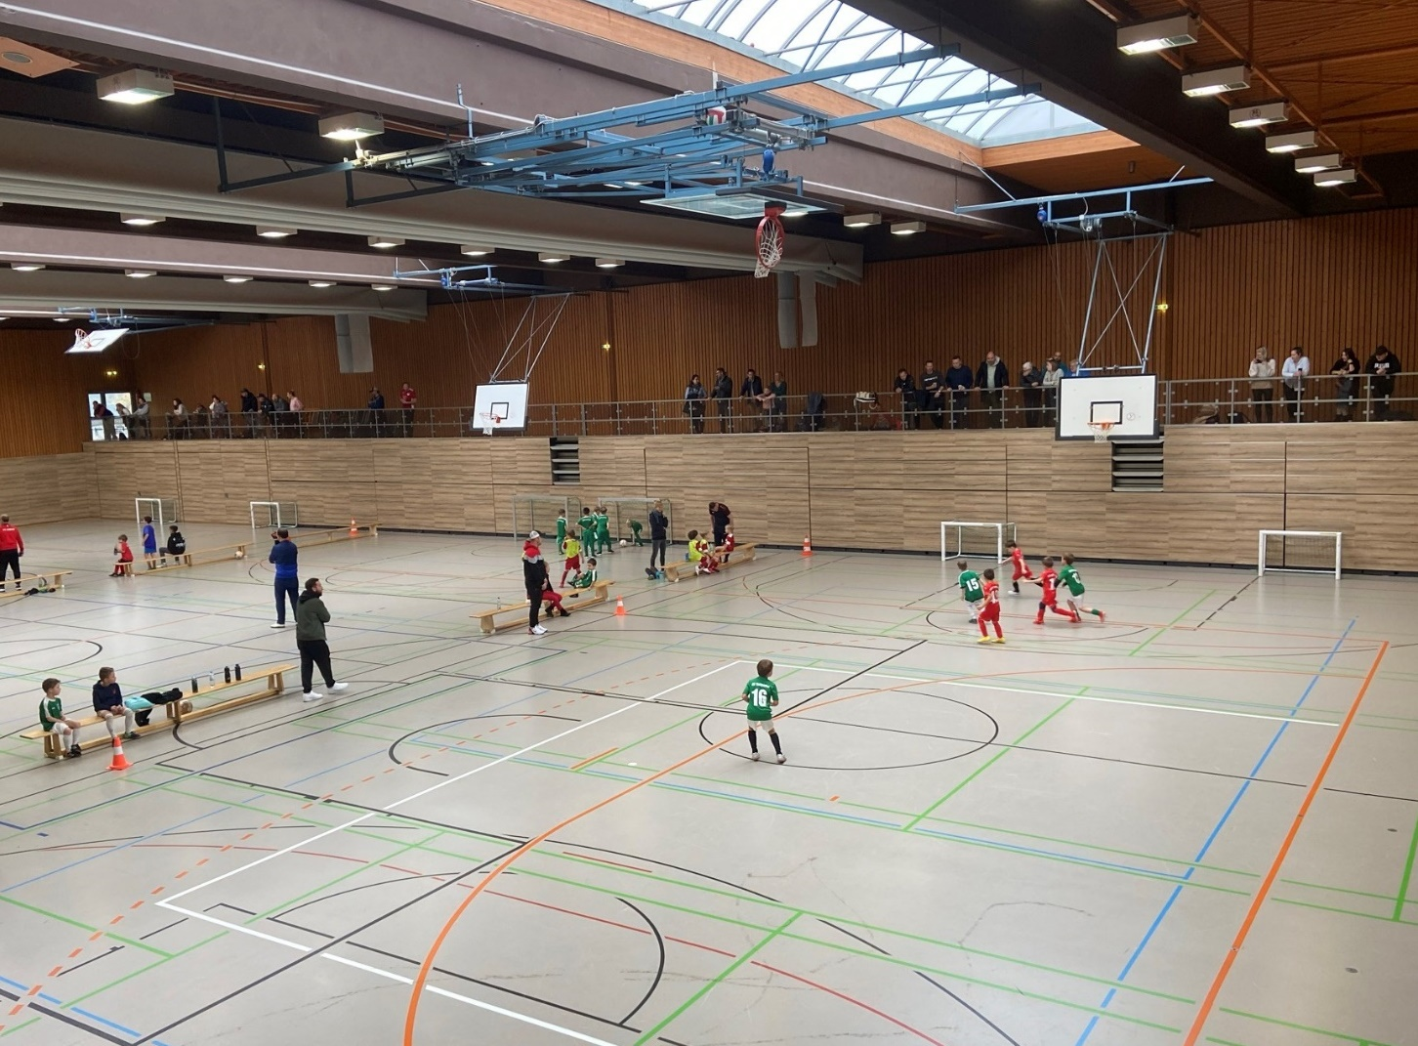
Facilities

Slide 13
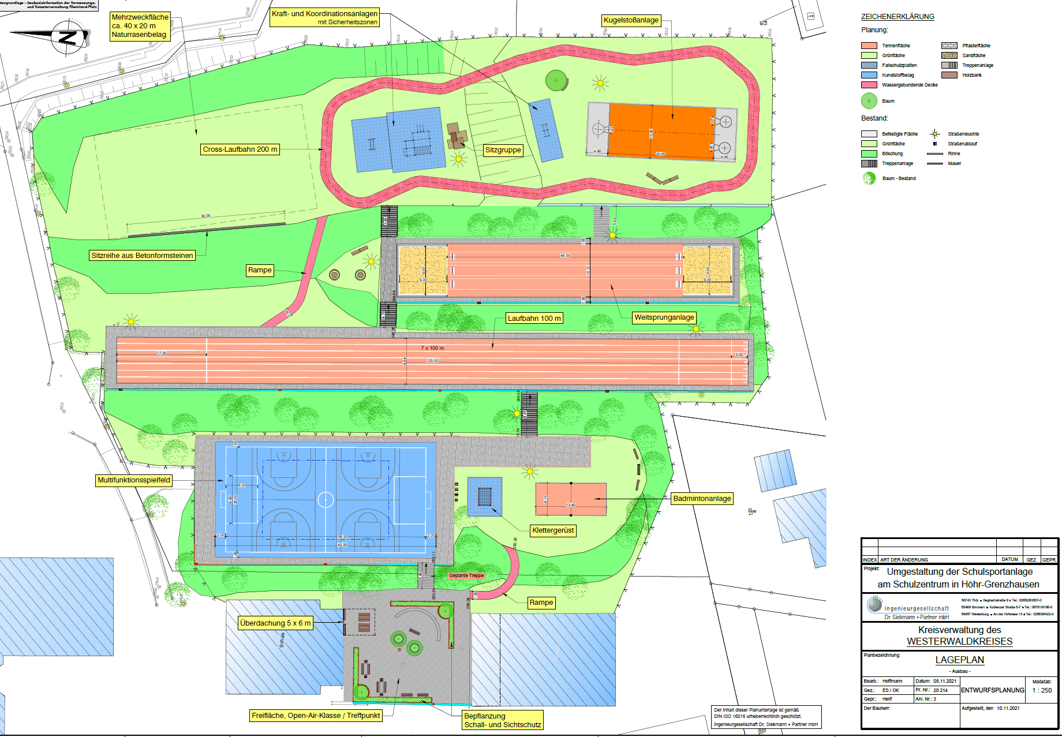
Work in progress
Construction Plan for 2024

Slide 14
Our Goals
Guiding our students to
autonomy
self-organization
personal responsability
self-confidence

Slide 15
Our methodology
Organisational flexibility
Individual support
Project-based learning
Compulsory optional subjects
Remedial teaching
55 minutes instead of 45 per lesson

Slide 16
Clubs
Library
Stage technology
Big Band
Football
Science club
Table tennis
Mediation
Guest students
Chess, etc.

Slide 17
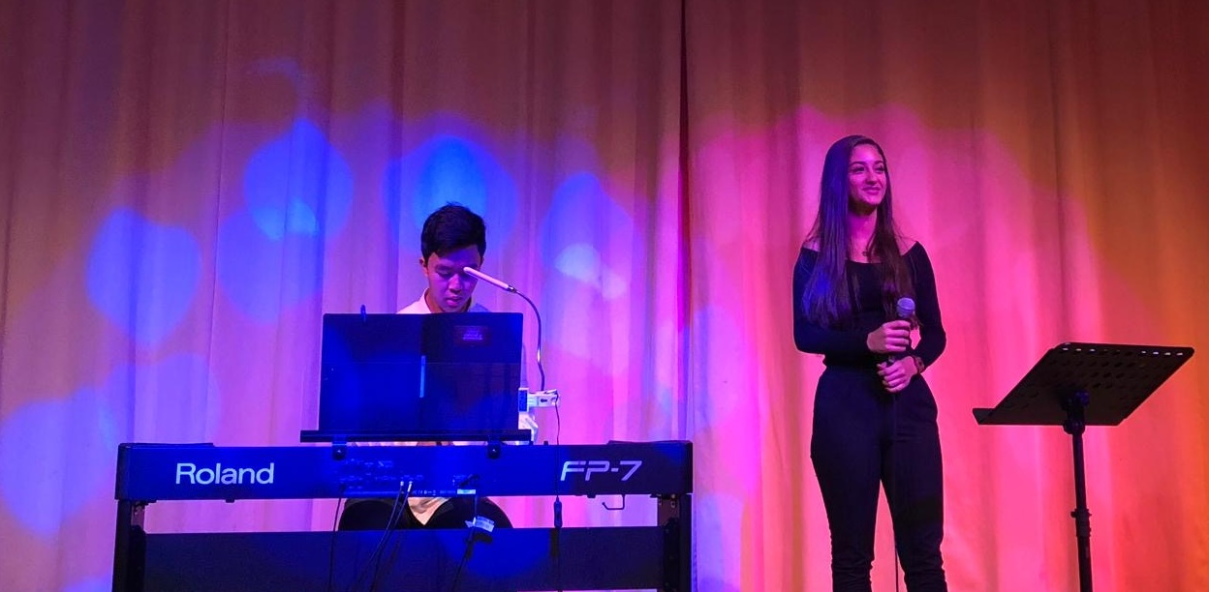
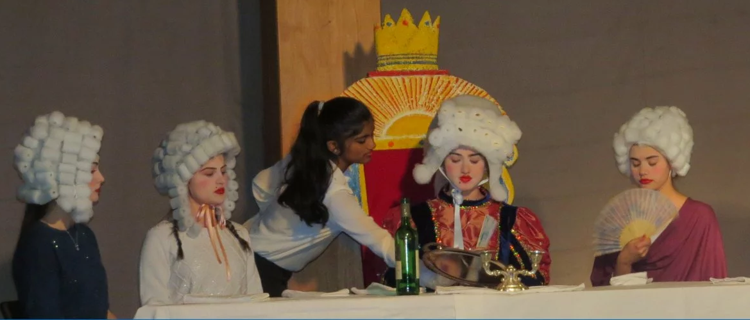
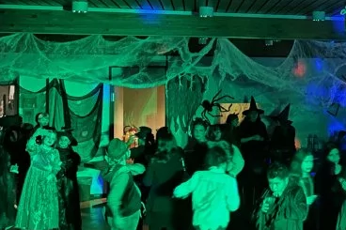
Activities

Slide 18
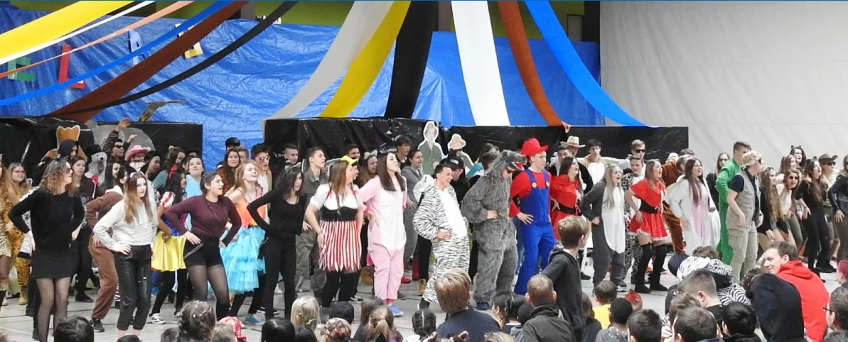
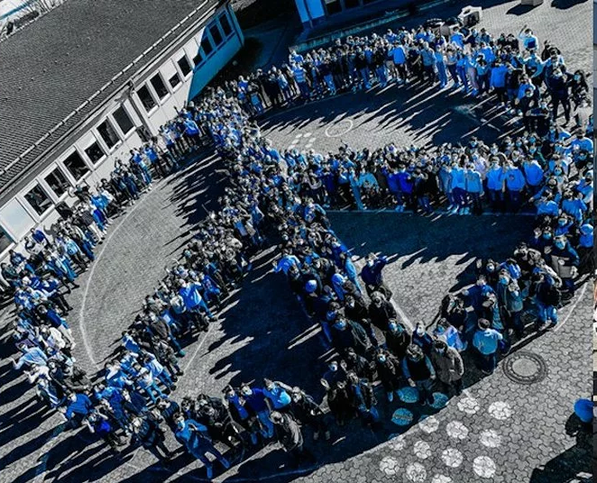
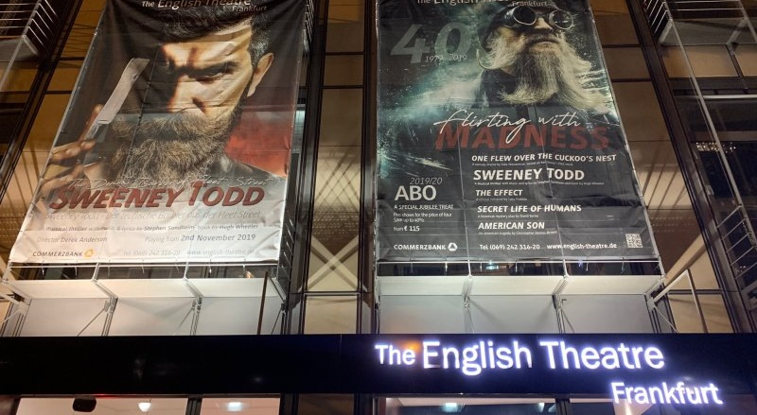
Activities

Slide 19
Celebrating our 50th birthday in 2024

Slide 20
Thank you for your attention!
See you at
http://www.gik-hg.de

